Slide 1
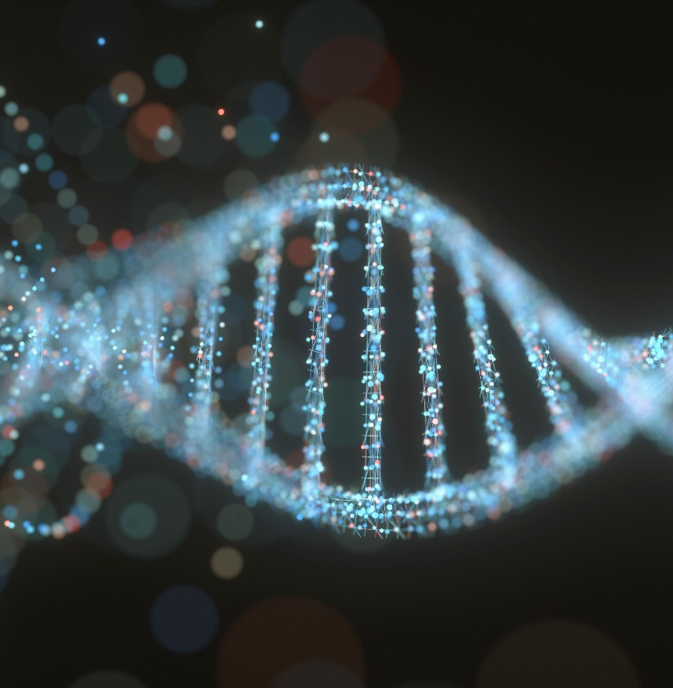

SCI225 · PATHOPHYSIOLOGY
Week Fourteen
Musculoskeletal & Integumentary
Dr. Vidya Aggrawal Nightingale College
// week 14 visual
Notes:
Welcome to Week 14 — the Musculoskeletal and Integumentary Systems. Bones, joints, muscles, and skin, plus the pediatric conditions you must recognize.

Slide 2

TODAY'S SESSION
Agenda
01
Bone & fracture
02
Joints & muscle
03
Pediatric musculoskeletal
04
Integumentary (skin)
SCI225 · WEEK 14
02 / 27
Notes:
Today's agenda — four sections.

Slide 3
WEEK FOURTEEN
Learning objectives
1
Describe bone disorders and fracture complications.
2
Differentiate joint and muscle disorders by mechanism.
3
Understand pediatric musculoskeletal conditions.
4
Discuss integumentary injury, inflammation, and the classic skin infections.
SCI225 · WEEK 14
03 / 27
Notes:
Four weekly learning objectives.

Slide 4
Weekly resources
Required reading
Clinical tools
Musculoskeletal structure & alterations chapter
Integumentary structure & alterations chapter
Week 14 Study Guide — covers all objectives
Compartment syndrome — the 6 P's
Fracture-healing stages
MSK & skin cheat sheet — highest-yield patterns
Supplemental
OA vs. RA vs. gout comparison
Pediatric rash pattern reference
SCI225 · WEEK 14
04 / 27
Notes:
Required reading and resources.

Slide 5

MODULE FOURTEEN
14
Week Fourteen
Bones, joints, muscles, and skin — osteoporosis and fractures, the arthritides and gout, muscular dystrophy, pediatric MSK, and skin disorders from burns to childhood rashes.
SCI225 · WEEK 14
05 / 27
Notes:
Open Module 14 — Week Fourteen.

Slide 6
ACTION ITEMS
What is due this week?
Week 14 Pre-Assessment — complete before the webinar.
Discussion — apply MSK or skin pathophysiology to a clinical scenario; initial post + 2 peer replies.
Webinar Quiz — covers bone, joint, muscle, pediatric MSK, and skin disorders.
Case Study — apply mechanisms to a patient presentation.
Webinar — osteoporosis, the arthritides, Duchenne, and skin conditions. Bring your reading notes.
SCI225 · WEEK 14
06 / 27
Notes:
What is due this week.

Slide 7
SECTION · BONE & FRACTURE
Section objective
1
Describe the metabolic bone diseases, how fractures heal, and the limb-threatening fracture emergencies.
SCI225 · WEEK 14
07 / 27
Notes:
Section 1 objective — bone and fracture.

Slide 8
Bone disorders
Disorder
Defect
Key clue
Osteoporosis
Loss of bone mass/density (resorption > formation)
Postmenopausal/elderly; fragility fractures (hip, wrist, vertebral); normal serum calcium
Osteomalacia (rickets in kids)
Inadequate mineralization of new bone — usually vitamin D deficiency
Soft, bendable bone; bone pain
Osteogenesis imperfecta
Genetic type I collagen defect → brittle bone
Frequent fractures from birth, blue sclerae
Key idea: osteoporosis = too little bone (normal mineralization, normal calcium). Osteomalacia = poorly mineralized soft bone (vitamin D). Osteogenesis imperfecta = bad collagen scaffold.
SCI225 · WEEK 14
08 / 27
Notes:
Bone disorders — osteoporosis, osteomalacia, osteogenesis imperfecta.

Slide 9
Fractures & emergencies
Healing: hematoma → soft callus → hard callus → remodeling (hematoma is first)
Emergency
Mechanism
Clues
Compartment syndrome
Swelling in a closed fascial compartment → ↑ pressure → ischemia/necrosis
Severe pain out of proportion, unrelieved by meds; swelling, numbness
Rhabdomyolysis
Muscle breakdown releases myoglobin, which precipitates in renal tubules
Acute kidney injury, dark/tea-colored urine, ↑ CK, hyperkalemia
Fat embolism
Fat from long-bone marrow enters circulation
Dyspnea, confusion, petechiae (12–72 hr after fracture)
Red flag: compartment syndrome → pain out of proportion, unrelieved by analgesia, tense swollen limb → surgical emergency (fasciotomy).
SCI225 · WEEK 14
09 / 27
Notes:
Fractures and emergencies — compartment syndrome, rhabdomyolysis, fat embolism.

Slide 10
KNOWLEDGE CHECK
Question 1
Which change explains vertebral compression fractures in osteoporosis?
A
Reduced bone mass/density weakens the vertebrae so they collapse under load
B
Excess bone formation
C
Defective collagen from birth
D
Poor mineralization of new bone only
SCI225 · WEEK 14
10 / 27
Notes:
Knowledge check — osteoporosis fractures.

Slide 11
KNOWLEDGE CHECK
Question 2
Several hours after a leg fracture, a patient has severe pain unrelieved by medication, increasing swelling, and numbness. Which mechanism explains the injury?
A
Increased compartment pressure limiting perfusion (ischemia)
B
Increased blood flow to the limb
C
Nerve regeneration
D
Bone remodeling
SCI225 · WEEK 14
11 / 27
Notes:
Knowledge check — compartment syndrome.

Slide 12
SECTION · JOINTS & MUSCLE
Section objective
2
Differentiate the arthritides (and gout), joint infection, and the muscle diseases by mechanism.
SCI225 · WEEK 14
12 / 27
Notes:
Section 2 objective — joints and muscle.

Slide 13
Joint disorders
Disorder
Mechanism
Clues
Osteoarthritis (OA)
"Wear and tear" — cartilage degeneration over time
Older age, weight-bearing joints, worse with use, brief morning stiffness
Rheumatoid arthritis (RA)
Autoimmune synovial inflammation (pannus) destroys the joint
Symmetric small joints, prolonged morning stiffness, systemic; autoantibodies
Gout
Uric acid (urate) crystals deposit in the joint → intense inflammation
Sudden severe pain/redness, classically the great toe
Septic arthritis
Bacterial infection in the joint destroys cartilage
Hot, swollen, painful joint + fever — emergency
Key idea: OA = mechanical degeneration (asymmetric, worse with use). RA = autoimmune (symmetric, systemic). Gout = crystals. Septic arthritis = infection (fever + one hot joint).
SCI225 · WEEK 14
13 / 27
Notes:
Joint disorders — OA, RA, gout, septic arthritis.

Slide 14
INHERITED & ACUTE
Muscle disorders
Duchenne muscular dystrophy: absent dystrophin (X-linked) → fragile muscle membranes → fibers break down and are replaced by fat/fibrosis → progressive weakness. Gowers sign, calf pseudohypertrophy, ↑ creatine kinase.
Spinal muscular atrophy (SMA): motor neuron degeneration → muscles lose nerve input → decreased tone and atrophy.
Strain vs. sprain: overstretch/tear of muscle-tendon (strain) or ligament (sprain); a severe sprain fully tears the ligament → joint instability.
Pearl: Duchenne is X-linked recessive — almost always boys. Damaged muscle leaks CK, so creatine kinase is elevated.
SCI225 · WEEK 14
14 / 27
Notes:
Muscle disorders — Duchenne, SMA, strains and sprains.

Slide 15
KNOWLEDGE CHECK
Question 3
A patient develops sudden severe pain, redness, and swelling in the great toe. Which is most likely, and what is the mechanism?
A
Gout — uric acid (urate) crystal deposition triggers acute inflammation
B
Osteoarthritis — cartilage wear
C
Septic arthritis — bacteria
D
Rheumatoid arthritis — symmetric autoimmune
SCI225 · WEEK 14
15 / 27
Notes:
Knowledge check — OA versus RA.

Slide 16
KNOWLEDGE CHECK
Question 4
Why does muscle weakness progressively worsen in Duchenne muscular dystrophy?
A
Muscle fibers break down faster than they can be repaired and are replaced by fat/fibrosis
B
Bones lose mineral over time
C
Nerves regenerate abnormally
D
Cartilage degenerates
SCI225 · WEEK 14
16 / 27
Notes:
Knowledge check — Duchenne muscular dystrophy.

Slide 17
SECTION · PEDIATRIC MUSCULOSKELETAL
Section objective
3
Understand the congenital and growth-related MSK conditions — many hinge on the open growth plate.
SCI225 · WEEK 14
17 / 27
Notes:
Section 3 objective — pediatric musculoskeletal.

Slide 18
Pediatric hip, foot & spine
Condition
Mechanism / hallmark
Developmental dysplasia of the hip (DDH)
Shallow hip socket doesn't hold the femoral head securely → instability/dislocation in infancy
Clubfoot
Congenital deformity holding the foot in an abnormal inward/downward position
Legg-Calvé-Perthes disease
Loss of blood supply to the femoral head → avascular necrosis in a child
Scoliosis
Lateral spinal curvature; rapid, uneven growth during a growth spurt can worsen the curve
Key idea: DDH = a structural socket problem; Legg-Calvé-Perthes = a blood-supply problem. Both affect the hip but the mechanisms are opposite — structure vs. perfusion.
SCI225 · WEEK 14
18 / 27
Notes:
Pediatric hip, foot, and spine — DDH, clubfoot, Perthes, scoliosis.

Slide 19
Growth-plate, bone & joint conditions
Condition
Mechanism / hallmark
Osgood-Schlatter disease
Repetitive patellar tendon traction on the tibial tubercle → pain/swelling below the knee in active adolescents
Sever disease
Repetitive Achilles traction on the calcaneal (heel) growth area → heel pain in active children
Osteomyelitis
Bone infection (often via blood) → fever, localized bone pain, refusal to bear weight
Nonaccidental trauma
Suspicious if injuries don't match the story — e.g., fractures at multiple healing stages
Traction apophysitis: Osgood-Schlatter (knee) and Sever (heel) are the same idea in two places — a tendon repeatedly pulling on an immature growth area during sports.
SCI225 · WEEK 14
19 / 27
Notes:
Growth-plate, bone, and joint — Osgood-Schlatter, Sever, osteomyelitis.

Slide 20
KNOWLEDGE CHECK
Question 5
Which alteration reduces femoral-head stability in developmental dysplasia of the hip?
A
A shallow acetabulum (hip socket) that doesn't hold the femoral head securely
B
Avascular necrosis of the femoral head
C
A torn ligament
D
Crystal deposition
SCI225 · WEEK 14
20 / 27
Notes:
Knowledge check — developmental dysplasia of the hip.

Slide 21
SECTION · INTEGUMENTARY SYSTEM
Section objective
4
Discuss skin injury and inflammation in adults, plus the classic pediatric and infectious rashes.
SCI225 · WEEK 14
21 / 27
Notes:
Section 4 objective — integumentary system.

Slide 22
Skin injury & inflammation
Condition
Mechanism
Burns (major)
↑ capillary permeability → massive fluid shift out of vessels → edema + hypotension (burn shock)
Cellulitis
Bacterial infection of dermis/subcutaneous tissue → warm, spreading (diffuse) redness, tenderness
Psoriasis
Chronic immune-mediated hyperproliferation → thick, raised, scaly plaques on elbows/knees/scalp
Pressure injury
Sustained pressure limits perfusion → ischemia & necrosis over bony areas (e.g., sacrum)
Herpes zoster (shingles)
Reactivation of latent varicella-zoster virus → painful vesicles in a single dermatome
Key idea: a major burn makes capillaries leaky → widespread edema and falling BP (burn shock) in the first hours → why fluid resuscitation is central to burn care.
SCI225 · WEEK 14
22 / 27
Notes:
Skin injury and inflammation — burns, pressure injury, cellulitis, psoriasis.

Slide 23
Pediatric & infectious skin conditions
Condition
Cause
Hallmark
Varicella (chickenpox)
Varicella-zoster virus
Itchy vesicles in multiple stages at once
Fifth disease
Parvovirus B19
"Slapped-cheek" red face → later a lacy rash
Impetigo
Staph/Strep entering minor breaks
Weeping lesions with honey-colored crusts
Scabies
Mite burrowing in skin
Intense itching, worse at night; spreads in households
Tinea (ringworm)
Fungal infection of skin/scalp
Ring-shaped scaly patches; scalp hair loss (capitis)
Match the pattern: multiple stages at once = varicella · slapped cheek + lacy = fifth disease · honey crust = impetigo · night itching in a household = scabies.
SCI225 · WEEK 14
23 / 27
Notes:
Pediatric and infectious skin — the classic rashes.

Slide 24
KNOWLEDGE CHECK
Question 6
A patient with severe burns develops widespread edema and hypotension shortly after injury. Which mechanism explains it?
A
Increased capillary permeability shifting fluid out of the vessels
B
Decreased capillary permeability
C
Increased blood volume
D
Vasoconstriction raising blood pressure
SCI225 · WEEK 14
24 / 27
Notes:
Knowledge check — burns and fluid shift.

Slide 25
KNOWLEDGE CHECK
Question 7
A child has an itchy rash with fluid-filled lesions in multiple stages of healing. Which condition?
A
Varicella (chickenpox)
B
Impetigo
C
Fifth disease
D
Tinea
SCI225 · WEEK 14
25 / 27
Notes:
Knowledge check — childhood rashes.

Slide 26
“
Choose one MSK or skin disorder and trace it from its underlying mechanism — structure, perfusion, infection, or inflammation — to the patient's presenting signs. How would naming that mechanism shape your nursing assessment and teaching?
DISCUSSION PROMPT — WEEK 14
SCI225 · WEEK 14
26 / 27
Notes:
Discussion — applying MSK and skin pathophysiology.

Slide 27
“
Bone, joint, muscle, or skin — every disorder this week comes down to one of four questions: is it a problem of structure, perfusion, infection, or inflammation? Name it, and the patient's presentation explains itself. Congratulations on finishing the course.
DR. VIDYA AGGRAWAL · PATHOPHYSIOLOGY COURSE INSTRUCTOR · NIGHTINGALE COLLEGE
SCI225 · WEEK 14
27 / 27
Notes:
Closing — structure, perfusion, infection, inflammation.

